Slide 1
Safety Health and environmental
10/21/2021

Slide 2
Thank you for Breakfast

Slide 3
ANTI-TRUST GUIDELINES FOR CONDUCTING MEETINGS
HBR appreciates your willingness to be an important part of this organization and the services provided to our industry.
The following guidelines shall be followed in conducting meetings of HBR. This is not an exhaustive list of every possible subject to be avoided; in the event you have doubts about the propriety of any matter to be discussed in a meeting, our legal counsel is available for consultation. Generally, the anti-trust laws proscribe unlawful combinations or agreements. Sometimes “agreements” may be inferred from conduct. HBR wants to avoid even the appearance of impropriety and this is the spirit of these guidelines.
Do not discuss the prices of goods or services of any particular company(s).
Do not disparage the goods or services of any particular company(s)
Do not recommend the selection of any particular company as a supplier or customer
Do not urge or counsel that participating companies engage in any concerted activity to accomplish any unlawful purpose, i.e., boycotting any company or coercing a company to take some desired action.
Do not discuss matters which may be trade secrets or confidential to any company, i.e. don’t engage in “off the record” comments or state matters “not to be repeated out of this room”.
Do not propose secret or “rump” sessions after the official meeting is adjourned to discuss matters which cannot lawfully be discussed at the official meeting.
Do not recommend or sponsor the gathering of statistical data, the publishing of standards, or doing joint research without advance written approval of the Operating Committee of HBR.
Houston Business Roundtable’s purpose is to educate participating companies, so every company represented will be better informed and can make its own individual decisions. HBR members are not required to adopt the HBR recommendations or policies.
Thank you in advance for adhering to these guidelines.

Slide 4
PLEDGE OF ALLEGIANCE
I pledge allegiance to the flag
of the United States of America
And to the republic, for which it stands. One Nation, under God, Indivisible, With Liberty and justice for all.

Slide 5
Texas Pledge
Honor the Texas Flag; I pledge allegiance to thee, Texas, one state under God, one and indivisible.

Slide 6
HSEA Nominations
Coming Soon!

Slide 7
HBR Fall golf

Slide 8
Become a Partner/subscriber

Slide 9
Safety Moment
Safety Moment

Slide 10
Safety Council Update
Health and Safety Council – Houston & Baytown
Texas City
Industrial Safety Training Council (ISTC)
Brazosport Safety Council

Slide 11
OSHA Updates
Jorge Gomez, M.S., GSP, Compliance Assistance Specialist from the U.S Dept. of Labor | OSHA

Slide 12
Drug Awareness
Richard Clay

Slide 13
The Signs of Drug Abuse
10 cues you and your team can pick up.

Slide 14
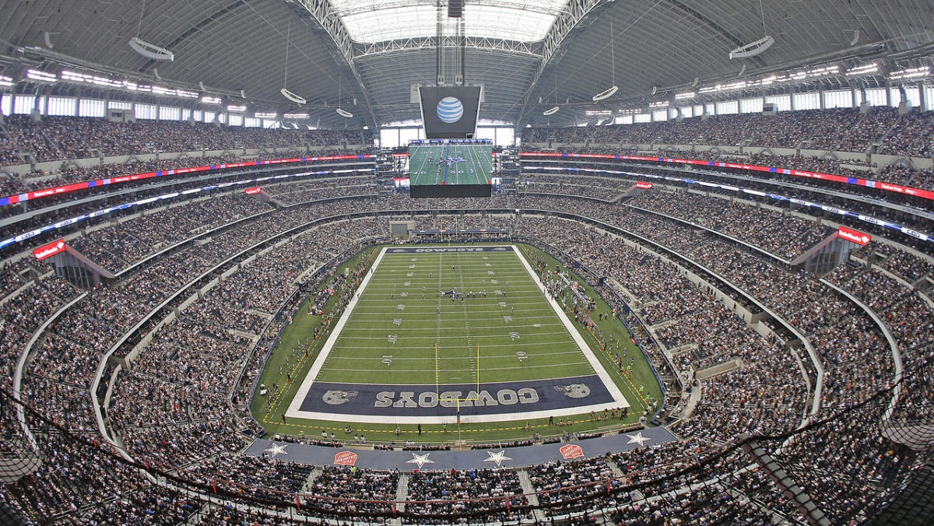
93,000 deaths in 2020.
60% by drugs most of us don’t know are being used.

Slide 15
History shows us that we should expect that stress, uncertainty & isolation have driven some in the labor pool to self-medicate and exacerbate or develop chemical dependencies.

Slide 16
Behavioral Impacts
Increased Substance Abuse Disorder (SUD)
New Threats
What has history taught us we might expect after COVID-19?

Slide 17
1
Neglecting important personal or professional responsibilities.
2
Isolating from family and friends.
3
New financial difficulties.
4
Lying or stealing from family, friends or other sources.
10 Signs of possible trouble.
5
Changes in eating habits or weight.
6
Frequent mood shifts.
7
Physical cravings.
8
Trouble with the law.
9
Frequent hospital visits.
Promising to quit "tomorrow."
10

Slide 18
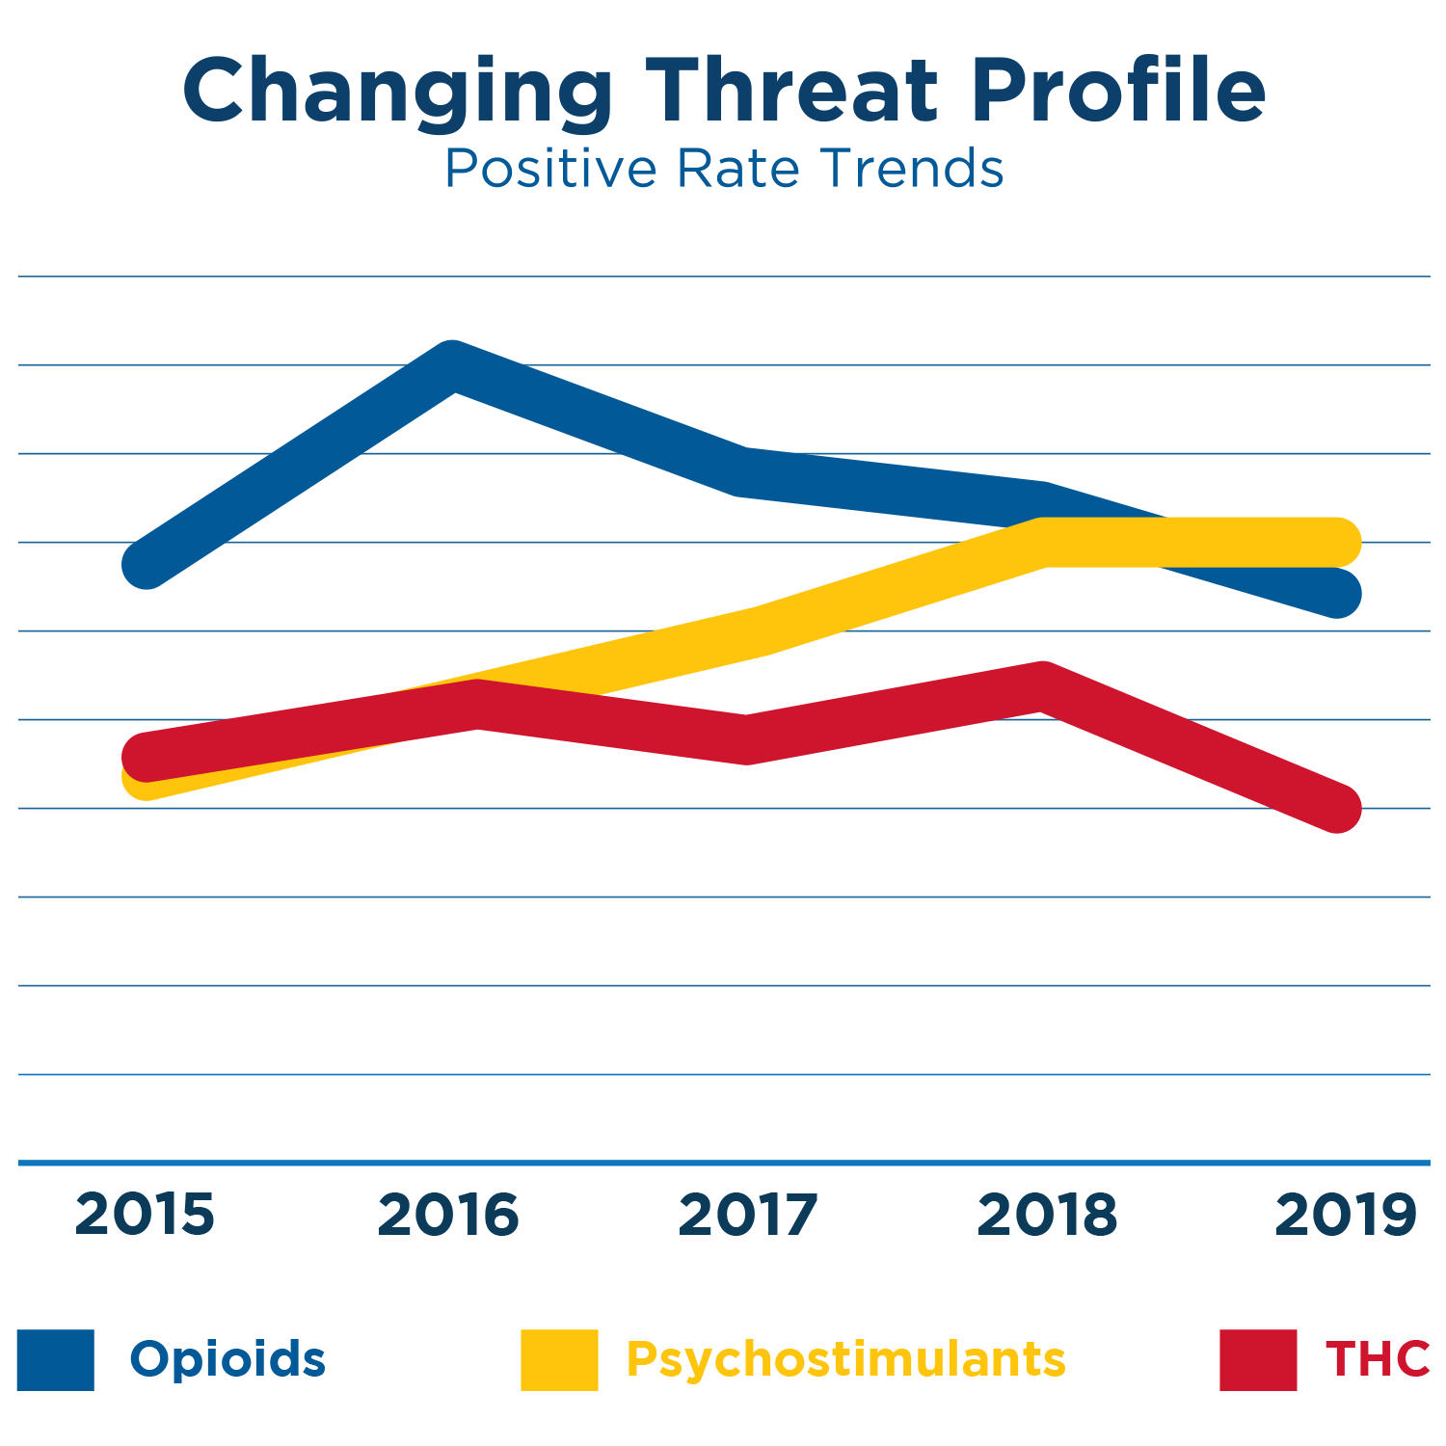
We expect trends we saw before COVID-19 to continue.
Psychostimulants and fentanyl continue to emerge as a growing threat.
Workplace vaping may follow trend in schools to THC (or other)-tainted oils.
“…with the successful reduction in the CPD availability, more users may shift to abusing heroin, illicitly produced synthetic opioids, and methamphetamine to obtain similar effects…”
DEA 2019 National Drug Threat Assessment

Slide 19
Member Asset Owner
Member Updates
New Site Information, Updates or Changes?

Slide 20
Focus Topic
Speaker John Minyard
Topic “Decision Making” Decisions leaders make in these uncertain times.

Slide 21
Final Business
Future Topics?
November Meeting is the same day as HBR Golf Tournament
December Meeting will be combined with Crane, Rigging and Lifting on December 14th Due to Christmas.
Meetings will be in person ongoing in the HASC Auditorium or Room 9. Look for announcements.

Slide 22
Questions?

Slide 23
Thank you for attending!
Contact us at Admin@houbrt.com

