Slide 1
Safety, Health and environmental
September 17, 2020

Slide 2
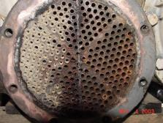
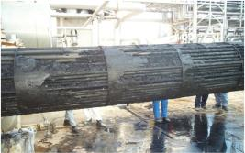
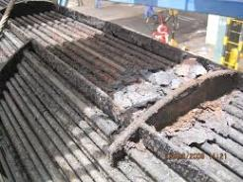
Why Hydroblasting
Client operations create fouling deposits such as sludge, rust and scale that build up on the surface of process equipment.
Refineries - Chemical Plants
Utilities - Upstream Oil and Gas
Steel Mills - Paper Mills
Eventually, passageways get restricted to where they can get plugged solid, stopping process reliability.
Hydroblasting is one of the quickest and best methods of removing these deposits.
10,000psi - 40,000psi

Slide 3
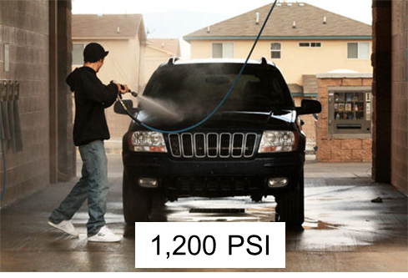
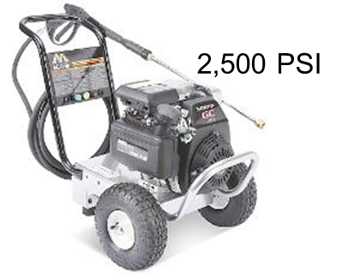
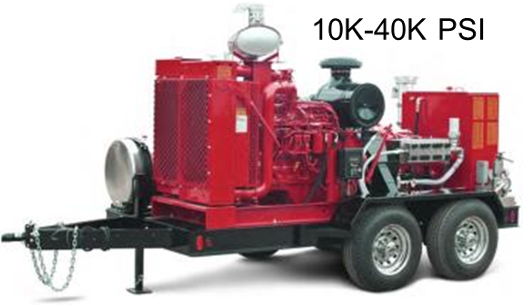
Hydroblasting force
Water leaving a Hydroblast nozzle has a tremendous amount of pressure…
Car Wash Around 1,200 PSI
Pressure Washer 1,500-2,500 PSI
Hydroblast Pump 10,000 – 40,000 PSI
PSI = Pounds Per Square Inch
Also, hydroblasting uses more water…
Car Wash/Pressure Washer Max 5 GPM
HB – 10K 10 GPM
HB – 20K 8 GPM
HB – 40K 5 GPM
As a result, hydroblast water streams carry a high amount of force

Slide 4
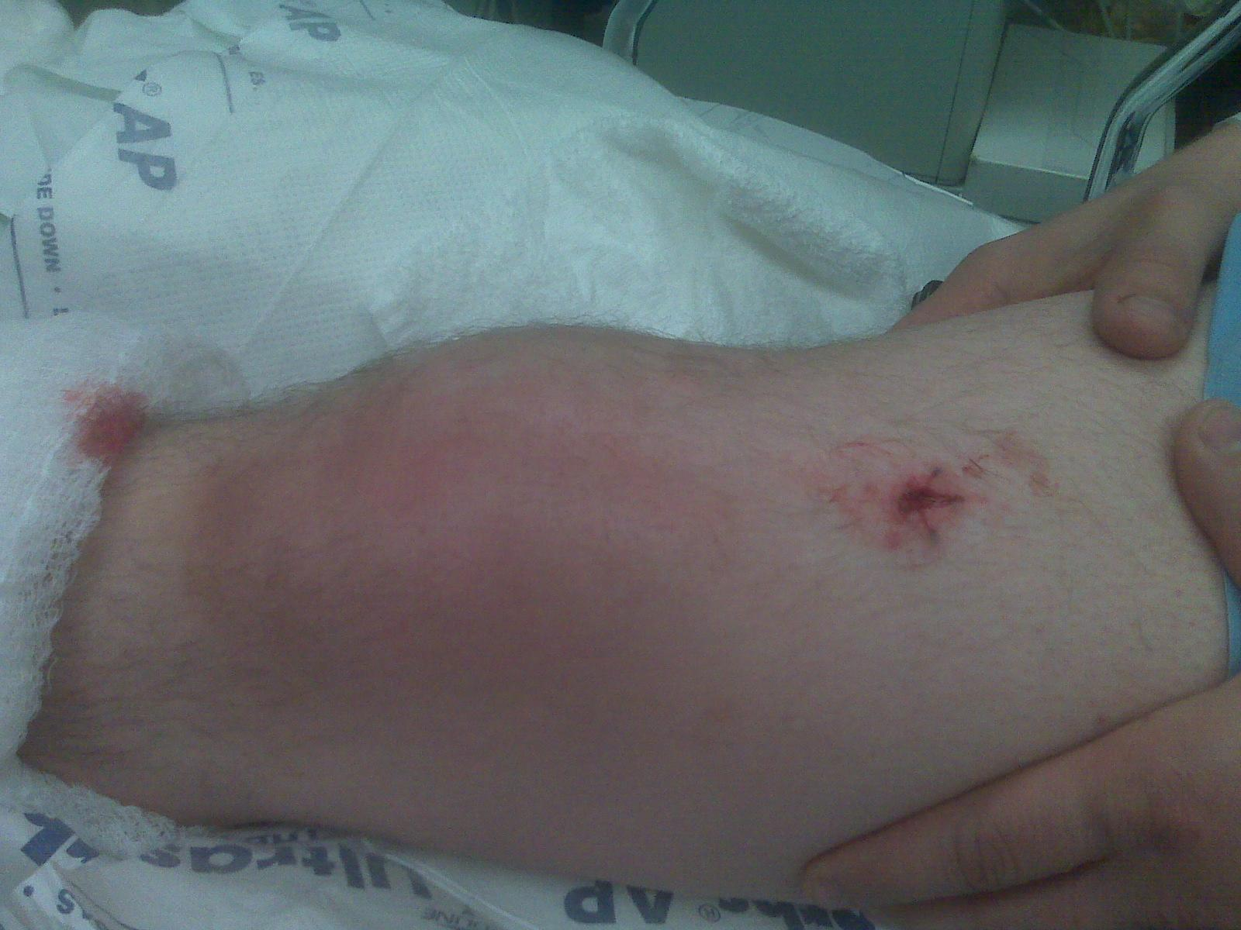
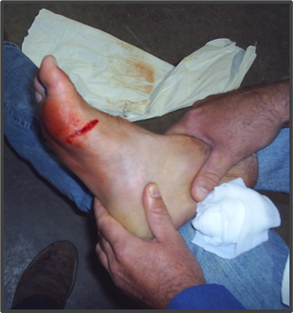
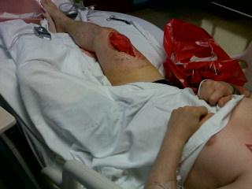
Hydroblasting Injuries
There are two major types of Hydroblast injuries
Watercuts – Where water injects into the skin
Struck by injuries where a water propelled Hydroblast tool strikes the body
These injuries are almost always severe
Entry wound on the right leg where water stream entered.
May 2010 - Michigan
Water swelled inside knee about the size of a softball…
resulting in surgery to clean impurities and let the wound drain.
July 2019 - Illinois
A worker decided to clean his boots with the high pressure water tool. He cut through the boots as well as his foot.
Doctors opened the foot to clean out the water resulting in a eight week recovery.

Slide 5
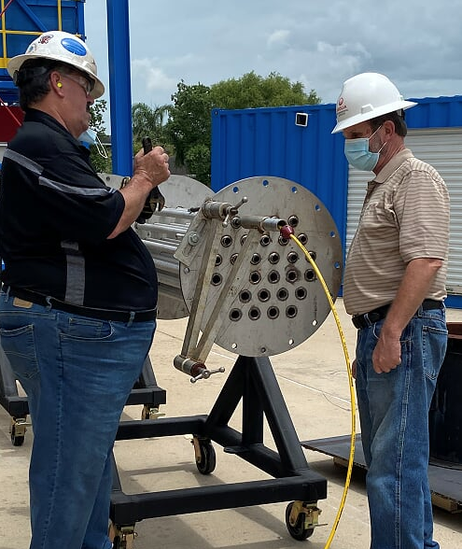
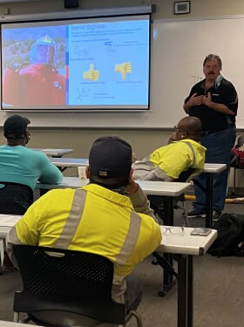
WJTA Foundational Training and Field Verification
Although injuries can be serious and even fatal, training requirements for end users vary and, in many cases may not exist.
It is our moral responsibility to put industrial cleaning technicians and operators in an environment that insures proper knowledge of industry best safety and operating practices.
WJTA has partnered with the Houston Area Safety Council (HASC) to develop a two-pronged approach to ensure HB craft certification for employees in the industry that consists of FT (Foundational Training) and FV (Field Verification) by a Verified Trainer.
This training is the result of dozens of end users, manufacturers, vendors and clients collaborating to provide the best safety and operational knowledge at the lowest possible cost.

Slide 6
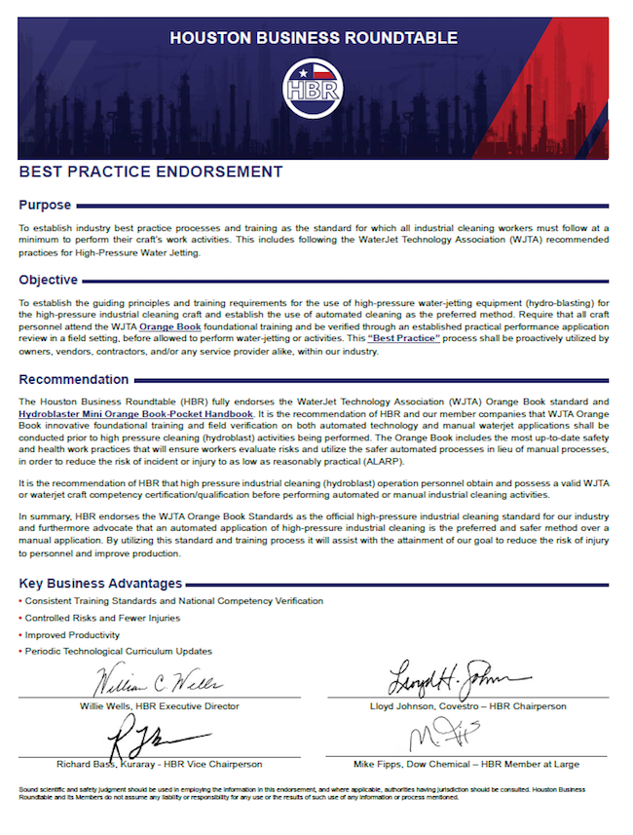
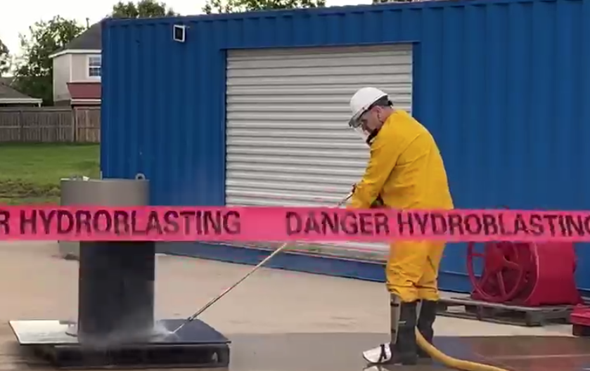
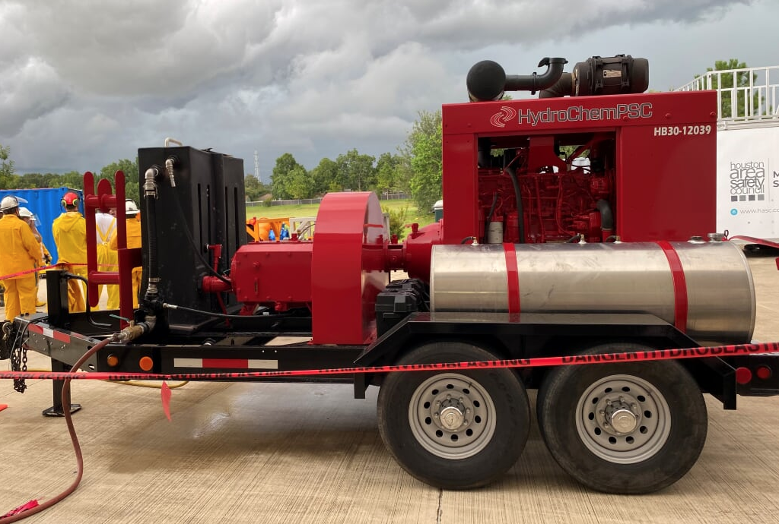
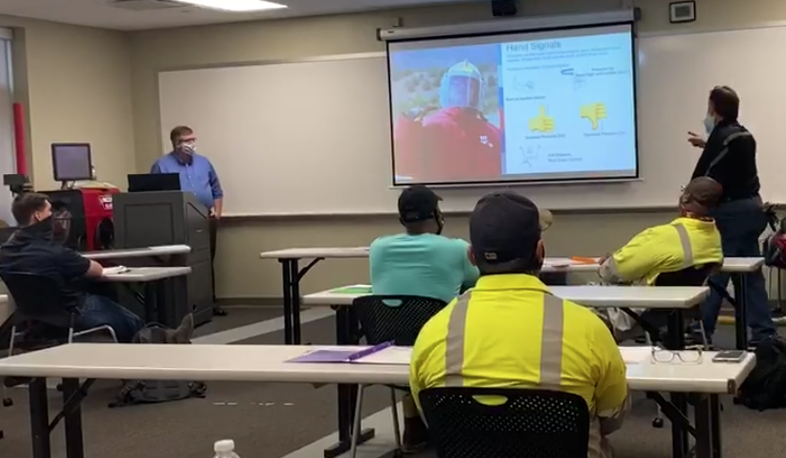
HBR Best Practice Endorsement
HBR fully endorses the WaterJet Technology Association (WJTA) Orange Book standard.
HBR recommends that high pressure industrial cleaning (hydroblast) operations personnel obtain a valid WJTA or waterjet craft certification before performing automated or manual industrial cleaning activities.
Utilizing this standard and training process will help attain the goal to reduce the risk of injury to personnel and improve production.

Slide 7
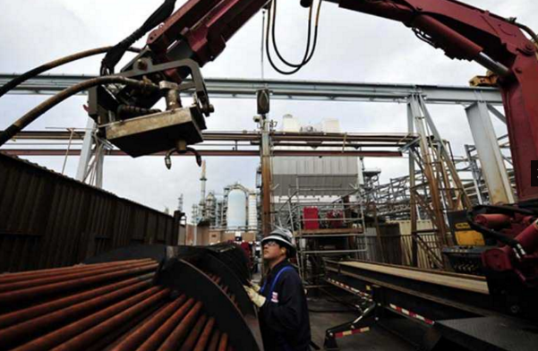
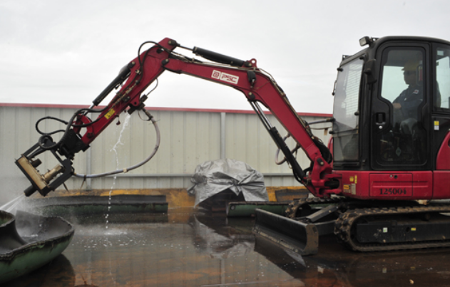
WJTA Automation Training
WJTA is already taking the lead to develop a follow-on certification that address automation and advanced hydroblasting techniques.
Additionally, the WJTA is updating and developing a Vacuum Services training that follows the same model as the FT/FV hydroblasting certification program.

Slide 8
Questions?

Slide 9
Thank you for attending!
Contact us at Admin@houbrt.com

