Slide 1




2025 SAFETY EXCELLENCE AWARDS | BEST PRACTICES SEMINAR
SOFT CRAFTS LARGE
BEST IN CLASS
Brock serves diverse industries, including petrochemical, refining, power generation, offshore, heavy manufacturing, pipelines and transmission, nuclear, and pulp and paper. Brock provides customers with solutions for scaffolding, painting, insulation, shoring, lead and asbestos abatement, fireproofing, facilities maintenance, and fabrication.

Slide 2


Slide 3
2025 SAFETY EXCELLENCE AWARDS | BEST PRACTICES SEMINAR
BEST PRACTICE
AGENDA / OUTLINE
Purpose
Execution & Implementation
Benefits & Results
Examples
Future Use & Applications
Summary & Wrap Up
Q&A

Slide 4


Slide 5


SHEILD Overview
2025 SAFETY EXCELLENCE AWARDS | BEST PRACTICES SEMINAR
Using OSHA’s example of VPP to promote HSE excellence and continuous improvement, Brock developed an internal safety recognition program known as SHIELD.
SHIELD is a worksite-based program that allows each Brock worksite to obtain recognition for exceeding requirements set forth by regulatory agencies, customers, and existing Brock programs.
SHIELD applies our belief that People following Processes provides the Protection to keep our employees from harm.
A successful evaluation is accomplished by driving into five core elements of our safety management system:
Bsafe Culture
Onboarding
Training
Hazard Recognition
Measurement

Slide 6
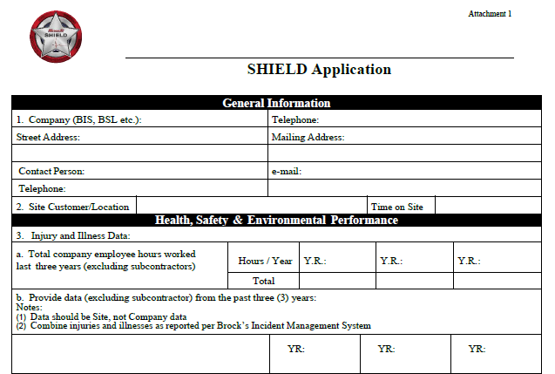
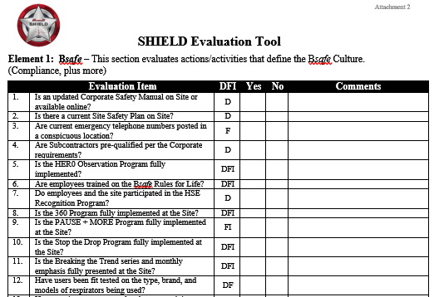
SHEILD Overview
2025 SAFETY EXCELLENCE AWARDS | BEST PRACTICES SEMINAR
Sites are nominated by Leadership
An application is submitted to the Shield team for review
­Must not have open regulatory actions and is free of regulatory citations for the past three years
Total Recordable Incident Rate (TRIR) of at least 90% less than the most recent year BLS rates for NAICS 238990, Specialty Trades Contractor
Evaluated on the Five Core Elements by Company HSE Professionals
162 questions
Documentation and field verification
Must score at least 95% to qualify
Major deficiencies immediately disqualify
All deficiencies corrected within 90 days

Slide 7
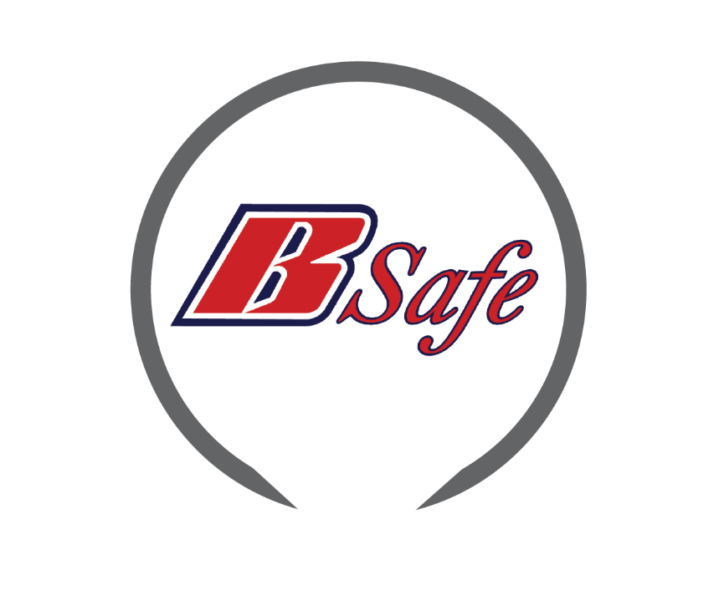



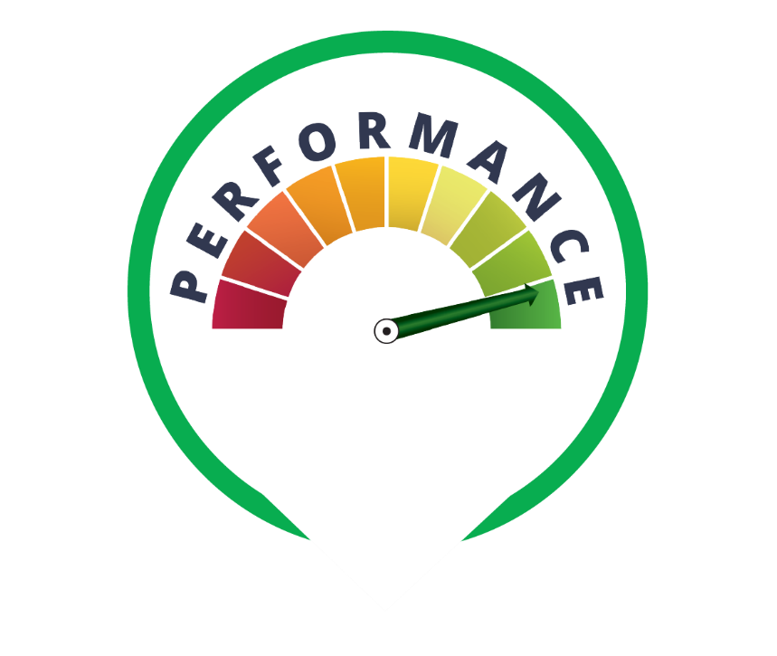
SHEILD Core Elements
2025 SAFETY EXCELLENCE AWARDS | BEST PRACTICES SEMINAR

Slide 8

Bsafe Culture
2025 SAFETY EXCELLENCE AWARDS | BEST PRACTICES SEMINAR
Culture of Respect and Caring
Take Safety to Heart
Bsafe HERØ
Bsafe Rules for Life

Slide 9
Onboarding
2025 SAFETY EXCELLENCE AWARDS | BEST PRACTICES SEMINAR
Training
New Employee Orientation​
Short Service Worker Program​
  Mentor Program​
  Enhances Training Programs
Supervisor Onboarding​
Client Orientations
OSHA Compliance
Company Specific Requirements
Craft Specific HSE Training​​
Leadership and Management​

Slide 10
Hazard Recognition
2025 SAFETY EXCELLENCE AWARDS | BEST PRACTICES SEMINAR
PAUSE + More​
  Pause, Assess, Understand, Share, Execute + More= Mitigate​
SHARP (Safety Hazard Analysis and Recognition Plan)​
  Individual pre-task analysis conducted by each crew member to identify hazards.​
L-JSA (Library Job Safety Analysis)​
  Pre-populated documents which outline key, specific risks of a given task, regardless of the setting. L-JSA’s are completed by subject matter experts and used as a reference during pre- job analysis by all crews.​
C-HAP ( Critical Hazard Analysis Plan)​
  C-HAP provides formal supervisory control measures when a critical high-risk task activity has been identified.

Slide 11
Measurement
2025 SAFETY EXCELLENCE AWARDS | BEST PRACTICES SEMINAR
Hero Observation Program​
  Peer to Peer Safety Observation program​
WSI ( Weekly Supervisor Inspections)​
  Performed by Foremen and above​
  Work practices driven​
Designated Program Administrator Audit (DPA)
  Quarterly audits conducted by Subject Matter Experts (SME) specific to areas of expertise
Management Safety Audits​
  Quarterly audits conducted by HSEQ and Project Management​
  Regulatory, client, and Brock requirement audit​

Slide 12
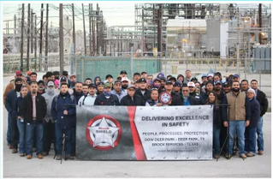
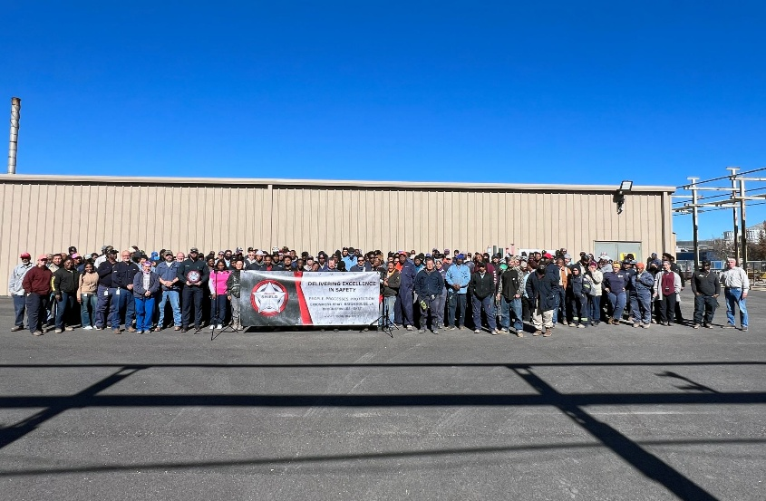
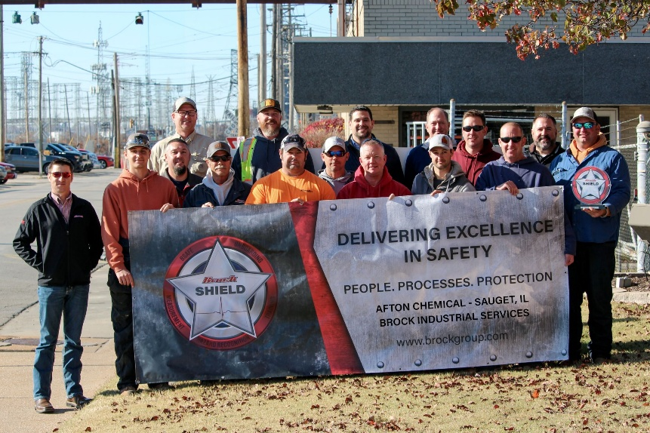
Summary
2025 SAFETY EXCELLENCE AWARDS | BEST PRACTICES SEMINAR
DOW Deer Park
Deer Park, TX - BSL Texas
Exxon Mobil
Baton Rouge, LA - BSL East
Afton Chemical
Sauget, Il - BIS

