Slide 1
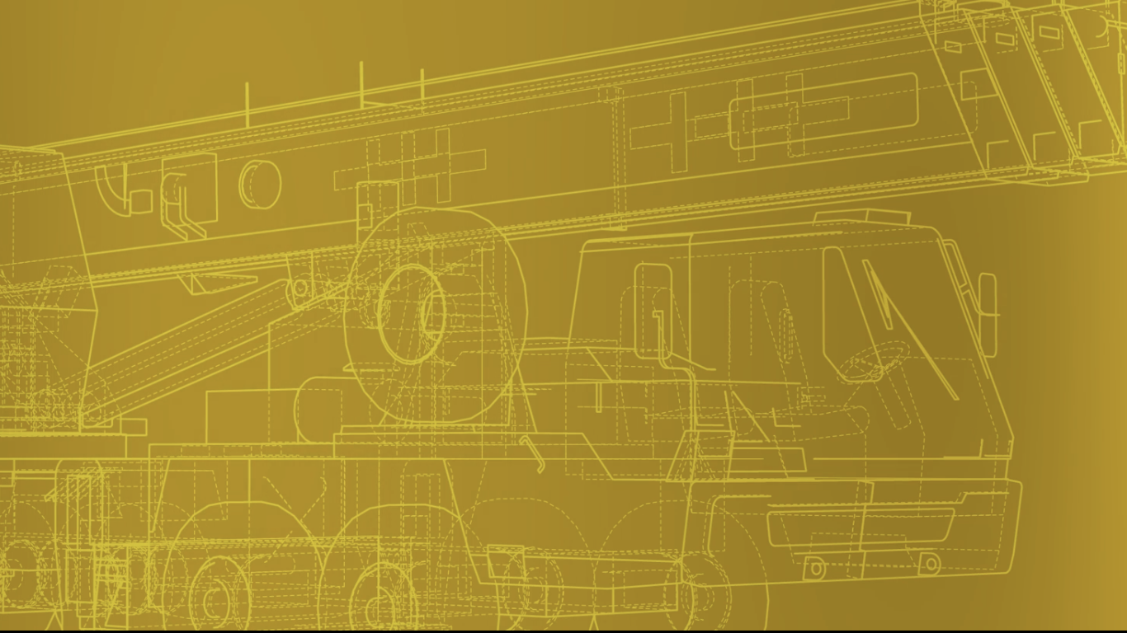


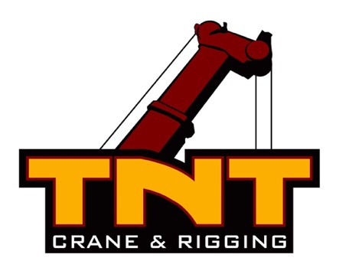
2025 SAFETY EXCELLENCE AWARDS | BEST PRACTICES SEMINAR
CRANE & RIGGING
BEST IN CLASS
Founded in 1985, TNT Crane & Rigging operates a modern fleet of more than 700 hydraulic trucks, all-terrain and crawler cranes ranging in lifting capacity from 9 up to 900 tons, plus a comprehensive inventory of specialized lifting and support equipment including gantry systems, cantilever beams, specialty forklifts, jack and slide systems, and rigging equipment. We specialize in combining skilled personnel with our specialized equipment to deliver customized solutions to satisfy specific lifting requirements. Customers are served 24/7 from 45 Branches across the US and Canada.

Slide 2

2025 SAFETY EXCELLENCE AWARDS | BEST PRACTICES SEMINAR

Slide 3
2025 SAFETY EXCELLENCE AWARDS | BEST PRACTICES SEMINAR
BEST PRACTICE
DOT Gate Checks
Purpose
Execution & Implementation
DOT Clean Inspection Incentive Program
Examples
Summary & Wrap Up
Q&A

Slide 4
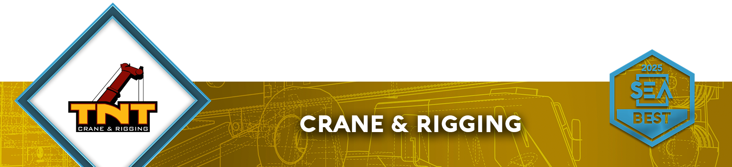
Purpose of DOT Gate Checks
2025 SAFETY EXCELLENCE AWARDS | BEST PRACTICES SEMINAR
DOT gate checks are designed to ensure every driver, truck, trailer and crane complies with FMCSA regulations, State regulations, and company policy, keeping our employees and public safe.
It is a critical step to prevent incidents before they happen and to reinforce our culture of safety and accountability.

Slide 5
Gate Check Process & Execution
2025 SAFETY EXCELLENCE AWARDS | BEST PRACTICES SEMINAR
Pre-Departure Inspections
Drivers must conduct a pre-trip inspection and verify load securement before arriving at the gate check station.
Any identified deficiencies must be corrected before transport begins.

Slide 6
Gate Check Process & Execution
2025 SAFETY EXCELLENCE AWARDS | BEST PRACTICES SEMINAR
2. Checkpoint Review
Each driver, truck, trailer and crane will be stopped at the gate for a visual and hands-on inspection.
Safety personnel will inspect the driver and vehicles for overall compliance.
If any issue is identified, it must be corrected immediately before the driver or vehicle is cleared for departure.

Slide 7
Gate Check Process & Execution
2025 SAFETY EXCELLENCE AWARDS | BEST PRACTICES SEMINAR
3. Driver Acknowledge & Accountability
Drivers are responsible for the vehicles they are operating and during the pre-trip inspection must sign off confirming compliance in Samara.
Any recurring violations will be addressed through additional training or corrective action.

Slide 8
Gate Check Process & Execution
2025 SAFETY EXCELLENCE AWARDS | BEST PRACTICES SEMINAR
4. Incident Reporting
Any violations or DOT concerns will be logged for tracking and trend analysis into TNT reporting system.

Slide 9
What We’re Looking for During Gate Checks
2025 SAFETY EXCELLENCE AWARDS | BEST PRACTICES SEMINAR
Driver connected to Samsara (Properly logged in and pre-trip/post trip completed)
Current paperwork of truck (Reg, Insurance, DOT annual inspection, Backup log, permits etc.)
Conditions inside of vehicle (Clear of debris, fire-extinguisher, triangles, etc.)
Outside visual inspection of vehicle (Lights, wipers, tires, vehicle components, audible air leaks, etc.)
Current paperwork of trailer (Reg, insurance and DOT annual inspection).
Visual inspection of trailer (Lights, tires, trailer components, audible air leaks, load securement)
Any identified deficiencies must by corrected before transport begins.

Slide 10

DOT Clean Inspection Incentive Program
The driver will receive a chip or token for each clean gate inspection. Once a driver has received five chips or tokens, they will be eligible for the incentive bonus.
The driver will receive a monetary reward through “HR Payroll Bonus” or a debit card for $250.00
Drivers with a consistent record of clean inspections will be publicly recognized and commended for their commitment to safety and compliance during weekly safety meetings.

Slide 11

Dot Gate Checks for 2025
January 2025 to Current Date
269 DOT Gate Checks conducted
170 of these checks found no findings
99 of these checks had findings
Vehicle Maintenance from December 2024 to April 2025 lowered by 2%.
HOS Compliance from December 2024 to April 2025 lowered by 9%.
Crash Indicator from December 2024 to April 2025 lowered by 8%.
Vehicle Maintenance and Driver is below National Average for Out of Service Violations.

Slide 12
Summary
2025 SAFETY EXCELLENCE AWARDS | BEST PRACTICES SEMINAR
Safety is Everyone’s Responsibility.
Gate checks are a proactive measure to prevent potentially catastrophic incidents and need every employee’s cooperation to make this initiative successful.
By taking the time to ensure compliance during these checks, we protect not only those of the public but also our own lives.

