Slide 1
2025 SAFETY EXCELLENCE AWARDS | BEST PRACTICES SEMINAR
ENVIRONMENTAL LARGE
BEST IN CLASS
Performance Contracting, Inc. is a specialty contractor that focuses on bundled services for our clients. Performance Contracting, Inc. specializes in all industrial services to include: hydro-excavating, vacuum trucks, scrubbers/degassing services, transportation, hydro-blasting, waste management, industrial cleaning maintenance, and soft crafts (insulation, scaffolding, and painting).

Slide 2
2025 SAFETY EXCELLENCE AWARDS | BEST PRACTICES SEMINAR

Slide 3
2025 SAFETY EXCELLENCE AWARDS | BEST PRACTICES SEMINAR
BEST PRACTICE
AGENDA / OUTLINE
Purpose
Execution & Implementation
Benefits & Results
Examples
Future Use & Applications
Summary & Wrap Up
Q&A

Slide 4
CDL Incentive & Safe Driving Program
2025 SAFETY EXCELLENCE AWARDS | BEST PRACTICES SEMINAR
CDL Incentive Program designed to reward employees for safe driving.
ADL Incentive Program designed to award all employees that drive equipment.
CDL Developmental Program is a talent development program used to promote our employees.

Slide 5
Mobile Violation Analytics
2025 SAFETY EXCELLENCE AWARDS | BEST PRACTICES SEMINAR
63 Total Mobile Violations in FY 2023
14 Total Mobile Violations in FY 2024
78% Decrease in Mobile Violations

Slide 6
Awardco
2025 SAFETY EXCELLENCE AWARDS | BEST PRACTICES SEMINAR
Platform designed to award and recognize our employees for safety excellence.
Leadership Driven
Monetary Point System
Peer to Peer Recognition

Slide 7
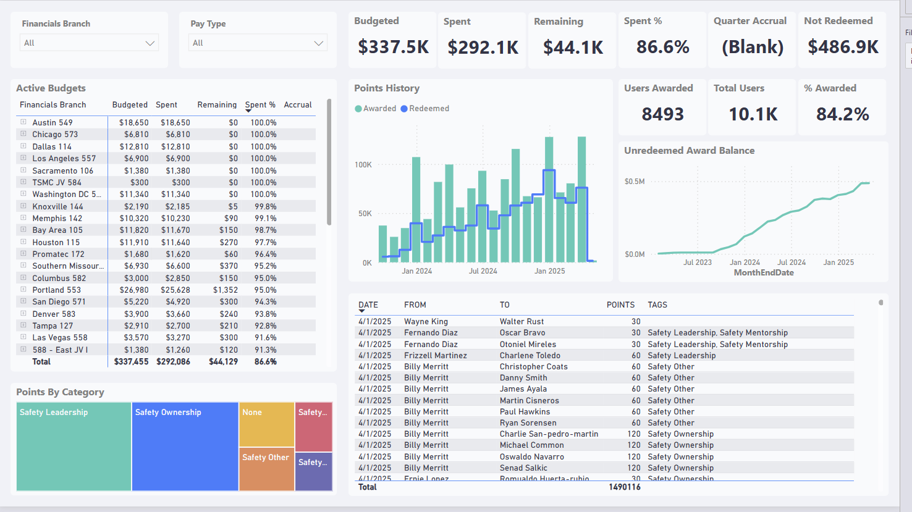
Awardco Analytics
2025 SAFETY EXCELLENCE AWARDS | BEST PRACTICES SEMINAR

Slide 8
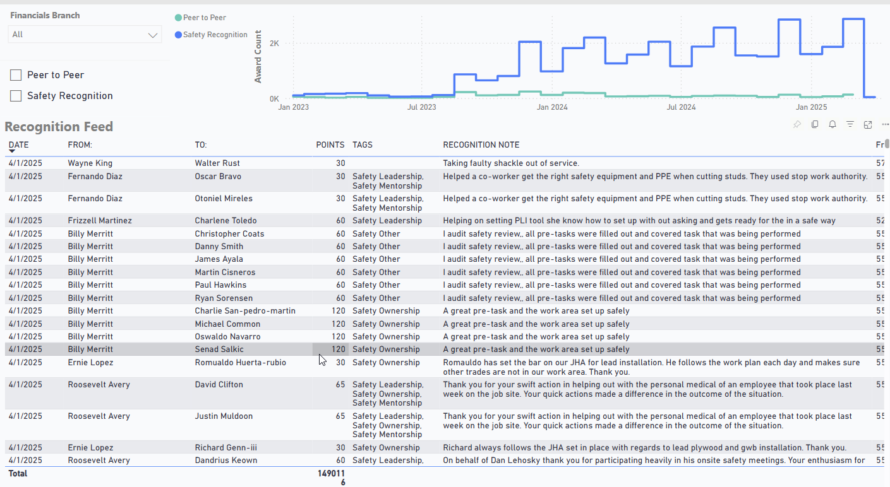
Awardco Recognition Feed
2025 SAFETY EXCELLENCE AWARDS | BEST PRACTICES SEMINAR

Slide 9
Employee Care Card
2025 SAFETY EXCELLENCE AWARDS | BEST PRACTICES SEMINAR

Slide 10
Employee Care Card Tracking Data
2025 SAFETY EXCELLENCE AWARDS | BEST PRACTICES SEMINAR
PCI Developed BBS / HOP Program
Streamlined into a Digital Database

Slide 11
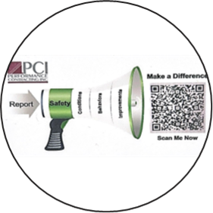
Summary
2025 SAFETY EXCELLENCE AWARDS | BEST PRACTICES SEMINAR
2024 Best Practices

Slide 12
Questions?
2025 SAFETY EXCELLENCE AWARDS | BEST PRACTICES SEMINAR

