Slide 1
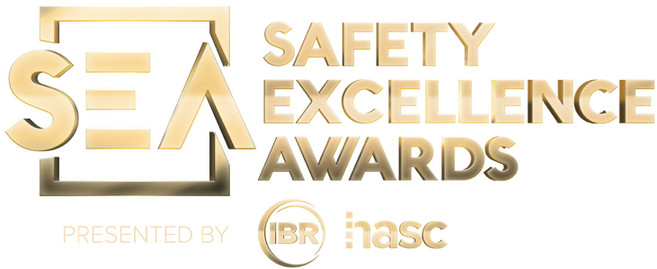
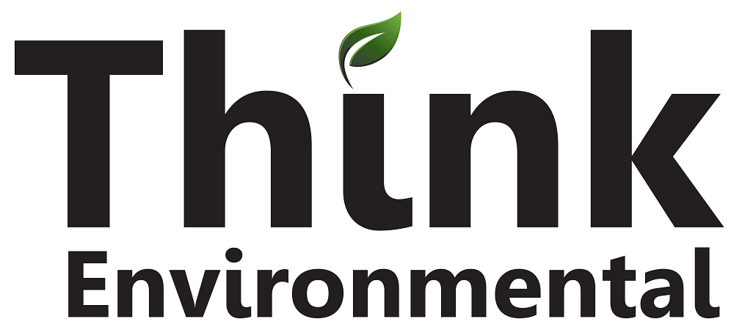
2025 SAFETY EXCELLENCE AWARDS | BEST PRACTICES SEMINAR
TECHNICAL SUPPORT MEDIUM
BEST IN CLASS
Best known for LDAR program management, Think Environmental offers a broad portfolio of environmental compliance services. We differentiate ourselves from our competition through best-in-class field operations based on management, leadership, and expertise that is unequaled in the industry.

Slide 2
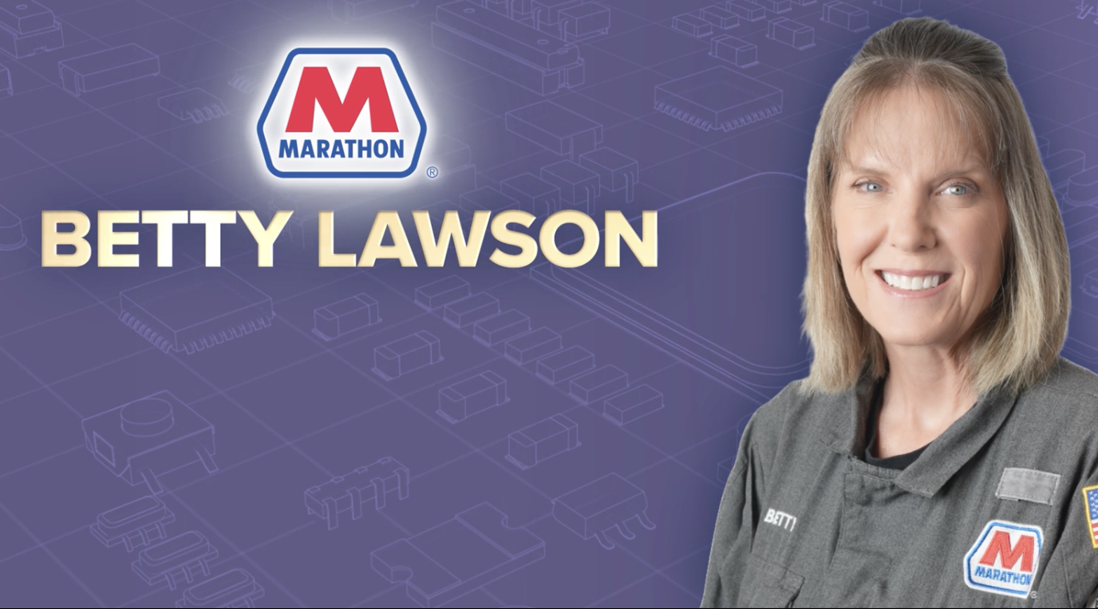

Slide 3
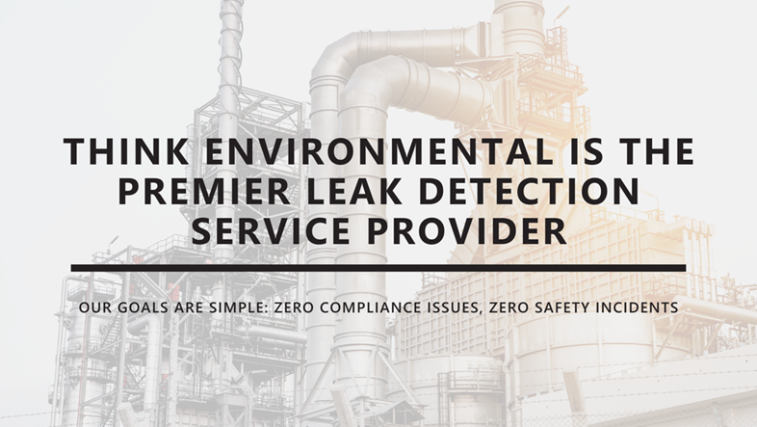
Who is Think Environmental?
2025 SAFETY EXCELLENCE AWARDS | BEST PRACTICES SEMINAR
Think Environmental is a safety-driven environmental services company specializing in LDAR (Leak Detection and Repair), emissions monitoring, and compliance support for industrial facilities.
We partner with refineries, chemical plants, and energy companies to deliver high-quality, reliable field services with a strong focus on data accuracy and regulatory compliance.
Known for our responsive team and commitment to safety, Think Environmental continues to grow by investing in our people, embracing technology, and building lasting client relationships

Slide 4
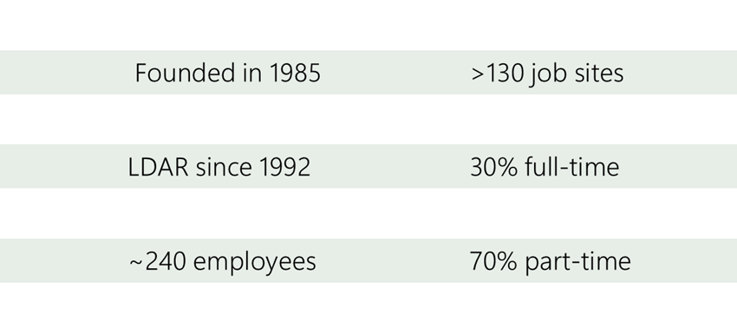
Our History: Built on Safety, Service & Growth
2025 SAFETY EXCELLENCE AWARDS | BEST PRACTICES SEMINAR

Slide 5
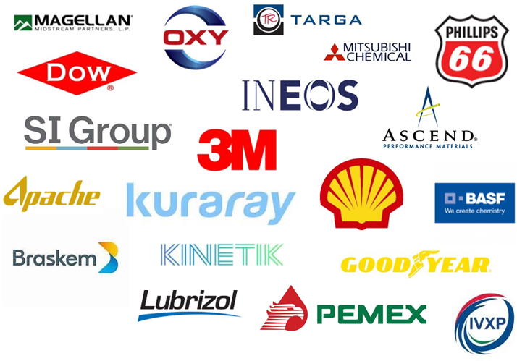
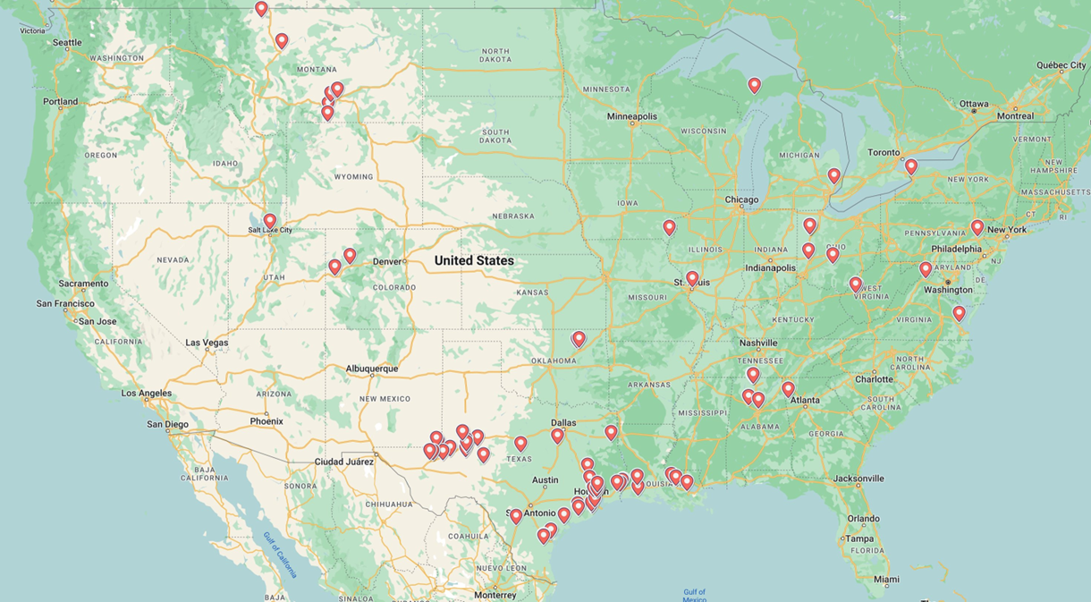
Customers & Locations
2025 SAFETY EXCELLENCE AWARDS | BEST PRACTICES SEMINAR

Slide 6
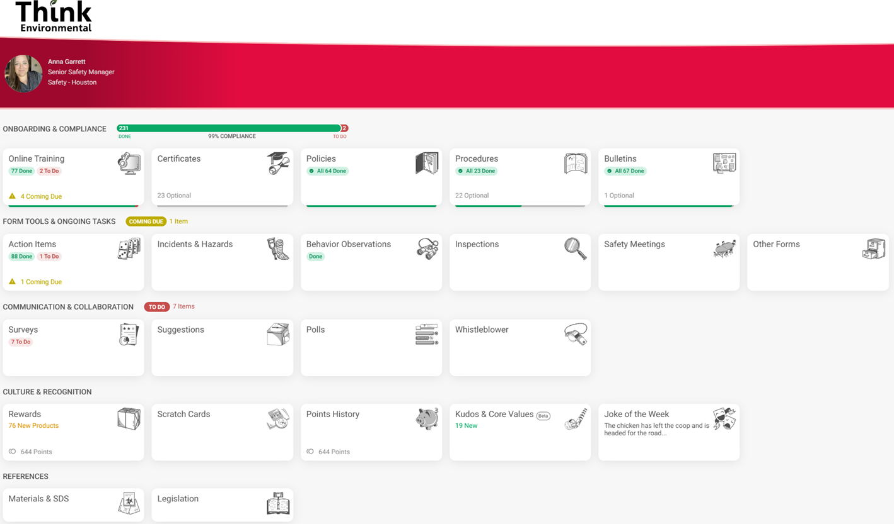
What is it?
2025 SAFETY EXCELLENCE AWARDS | BEST PRACTICES SEMINAR
Workhub is your all-in-one safety and compliance sidekick. It helps teams train smarter, track certifications, and manage safety tasks and is all in ONE place.
Safety Program Management
Incidents Tracking
Training Management
Document Control

Slide 7
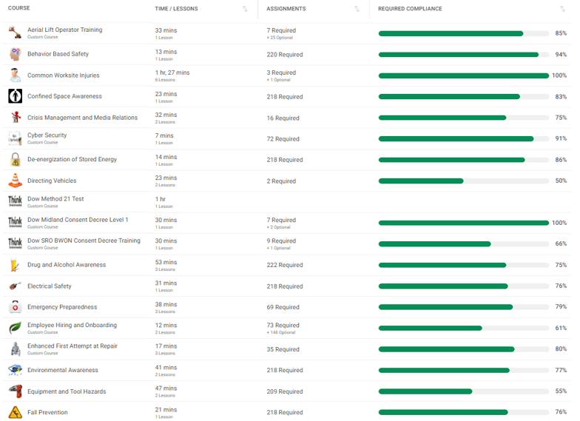
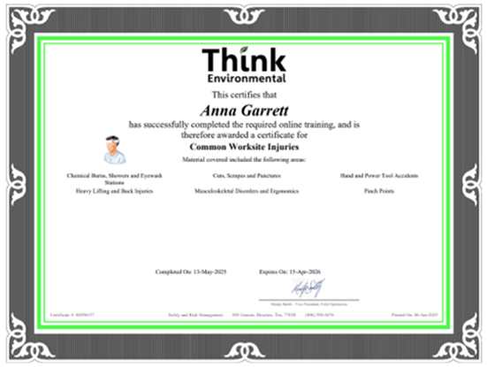
Training & Certifications
2025 SAFETY EXCELLENCE AWARDS | BEST PRACTICES SEMINAR
With Workhub
Centralized platform for assigning and tracking training
Real-time progress monitoring and expiration alerts
Supports H2S, site-specific, refresher, and weekly safety content
Ensures technicians are qualified before entering the field
Reinforces a culture of accountability and continuous learning

Slide 8
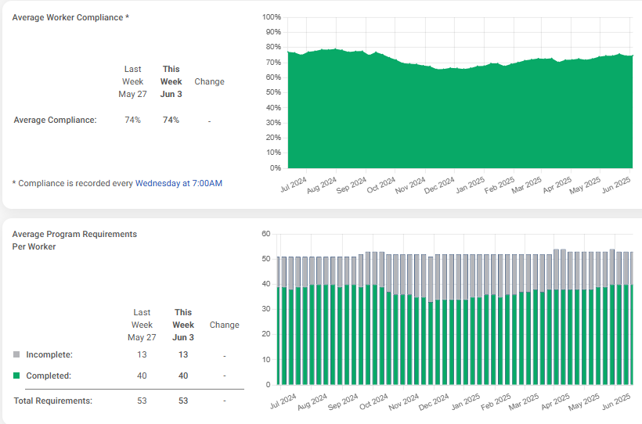
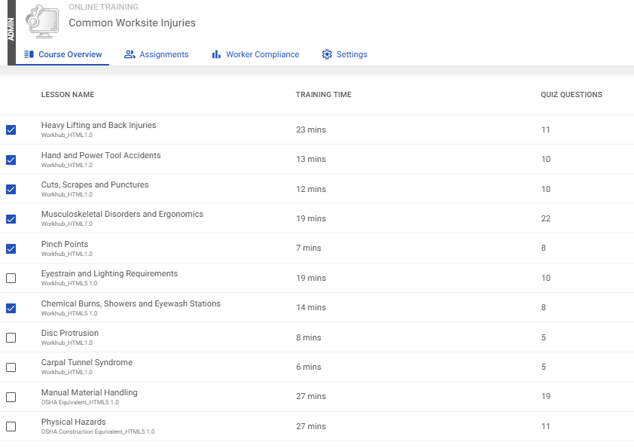
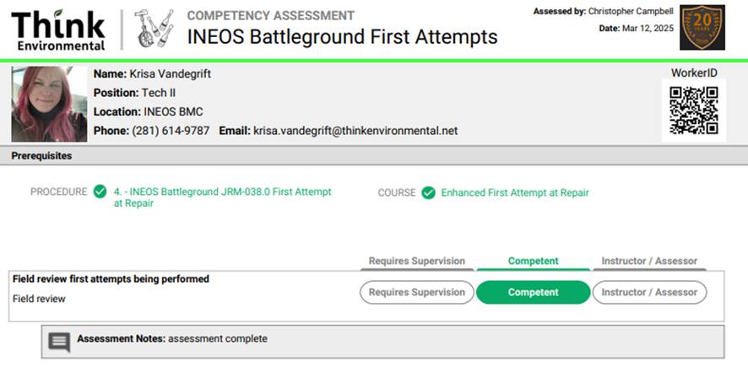
Training & Certifications
2025 SAFETY EXCELLENCE AWARDS | BEST PRACTICES SEMINAR
With Workhub
Customizable courses
Real time compliance tracking
Competency assessments

Slide 9
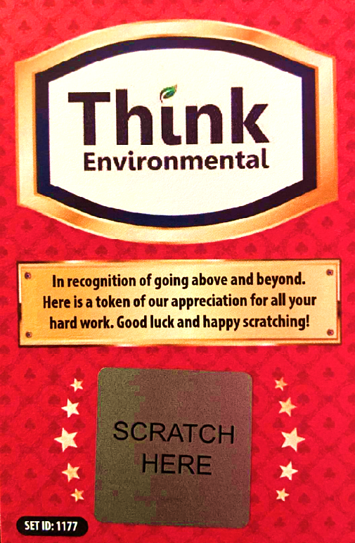
But here’s the BEST part!!
2025 SAFETY EXCELLENCE AWARDS | BEST PRACTICES SEMINAR
It includes a built-in incentive program.....
to reward employees for completing training, staying compliant, and participating in safety efforts. So, it’s not just about checking boxes - it’s about motivating your team to think safe and work proud
How Workhub' s Points System Works: Workhub turns safety and training into a game, with REAL rewards.
When employee's complete safety training, attend meetings, or meet compliance goals, they earn points.
These points can then be redeemed in the Workhub store for items like gift cards, tools, PPE gear, or company-branded merch.
It’s a fun and effective way to motivate your team, encourage participation, and keep safety top of mind - without needing constant reminders.

Slide 10
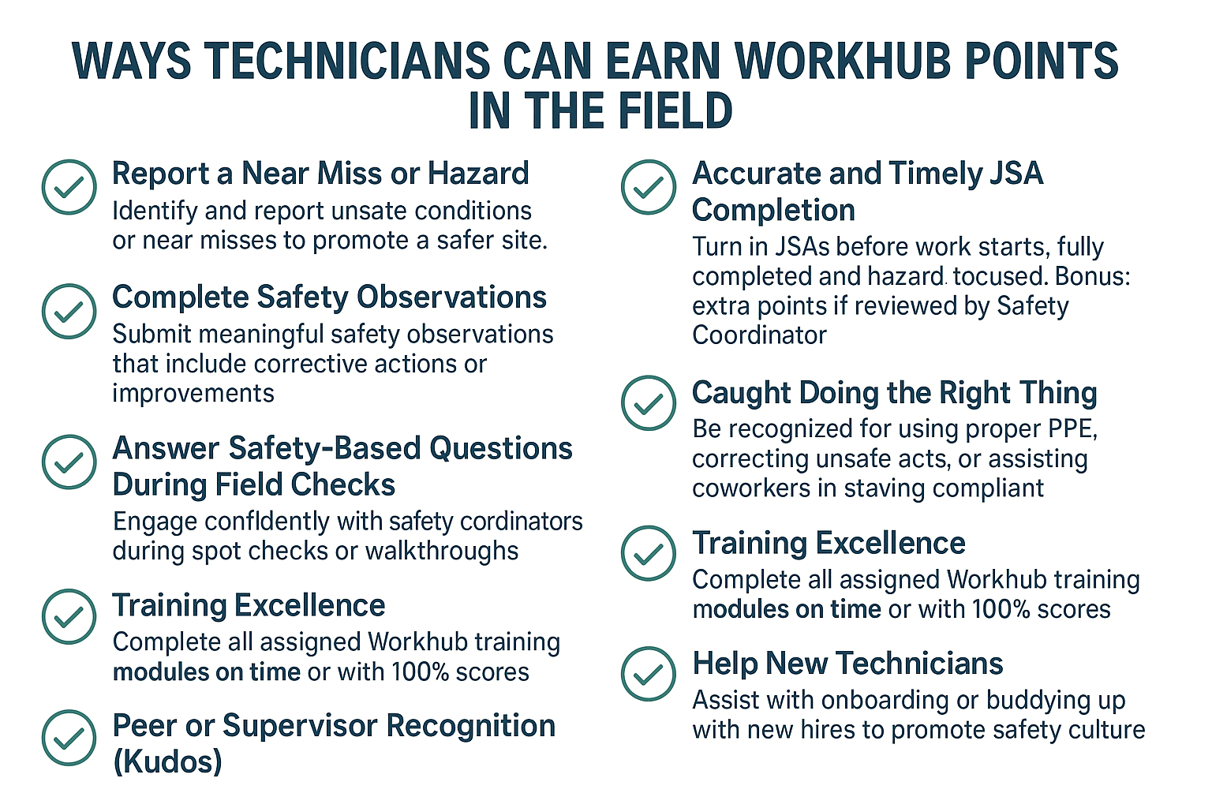

Slide 11
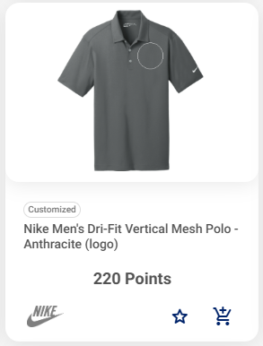
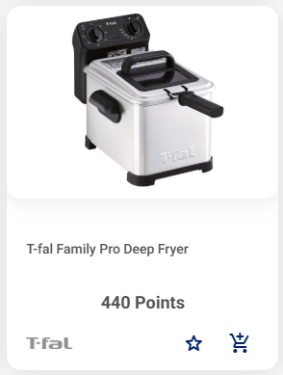
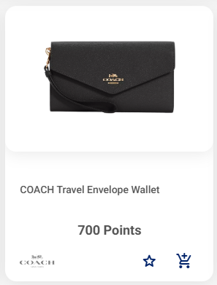
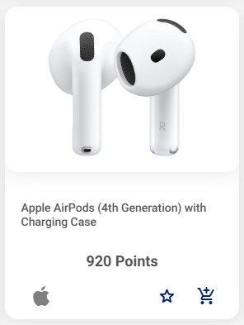
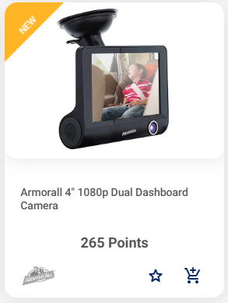
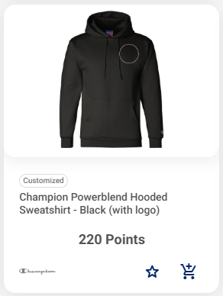
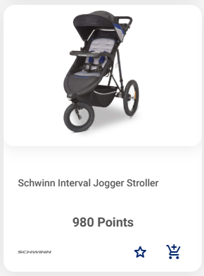
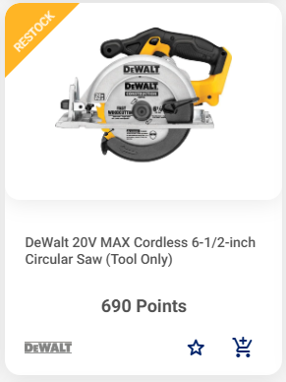
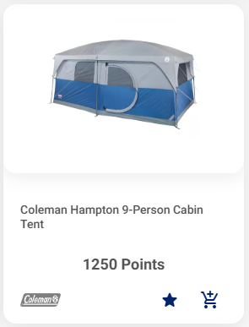
What your saved points can get you...
2025 SAFETY EXCELLENCE AWARDS | BEST PRACTICES SEMINAR

Slide 12
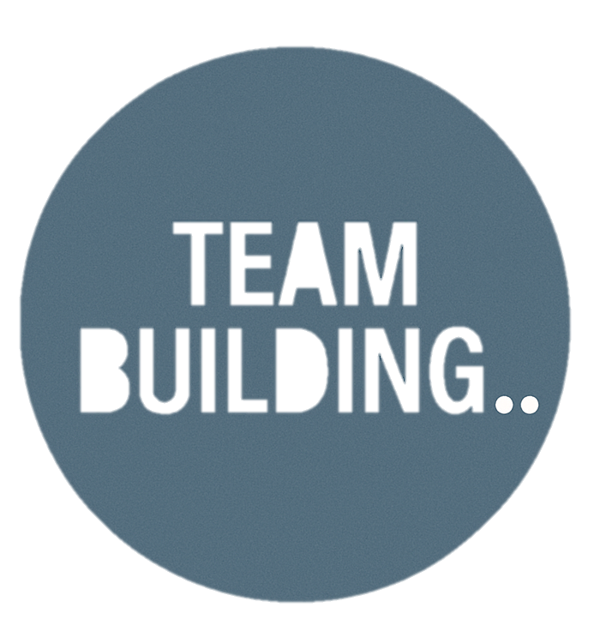
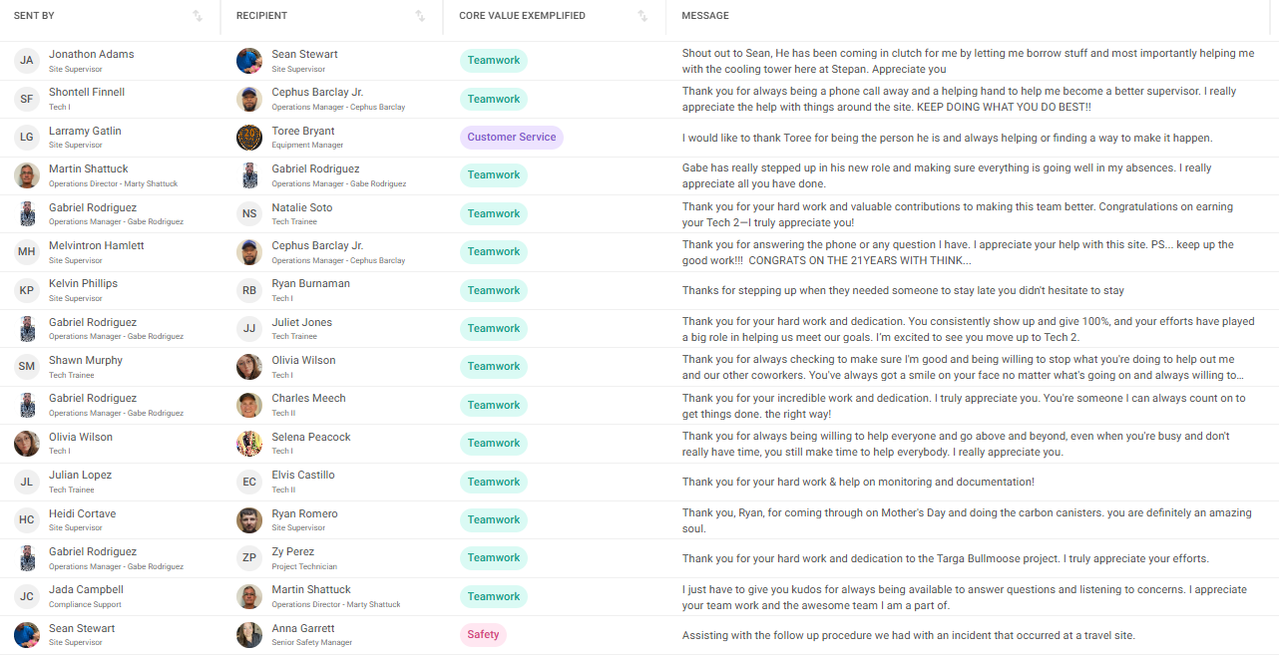
What is it?
2025 SAFETY EXCELLENCE AWARDS | BEST PRACTICES SEMINAR
Workhub supports team building by promoting peer recognition through the Kudos system, encouraging positive feedback, and rewarding safe behavior — helping strengthen relationships and boost team morale across all locations.
How Kudos Works:
Peer or Manager Recognition: Employees can be nominated by peers or supervisors for safe behavior, strong work ethic, or helping others, which promotes a culture of appreciation and respect.
Tied to Core Values: Kudos are linked to our core values, such as integrity, teamwork, safety, or excellence.
Visible to Everyone: The Kudos List is publicly displayed within the Workhub platform to promote a culture of positivity and peer recognition. Leadership regularly reviews kudos activity to stay connected with team performance and identify opportunities for broader recognition.

Slide 13
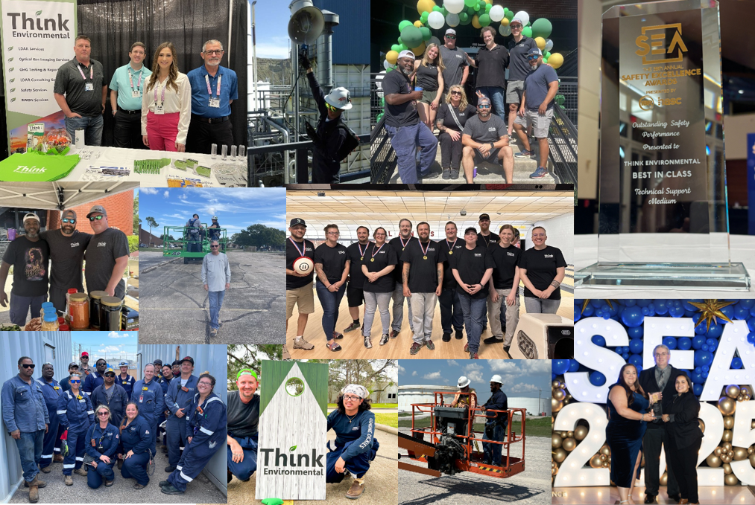
Summary
2025 SAFETY EXCELLENCE AWARDS | BEST PRACTICES SEMINAR
WHO WE ARE:
Think Environmental is a safety-focused environmental services company built on reliability, innovation, and strong client partnerships.
BEST PRACTICES:
By leveraging tools like Workhub, we've strengthened our training, communication, team culture, and recognition systems.
THE RESULT:
These practices helped us grow exponentially and to earn the 2025 Safety Excellence Award from IBR — recognizing us as Best in Class in our industry.

Slide 14
Questions?
2025 SAFETY EXCELLENCE AWARDS | BEST PRACTICES SEMINAR

