Slide 1
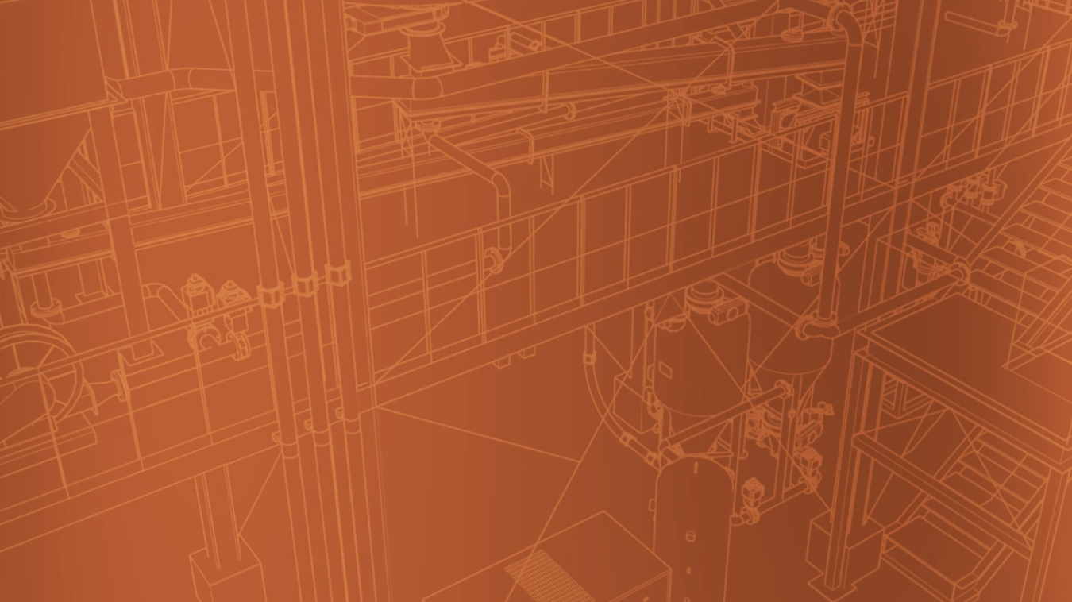
2025 SAFETY EXCELLENCE AWARDS | BEST PRACTICES SEMINAR
GENERAL CONTRACTOR MEDIUM
BEST IN CLASS
Founded in 1959, Norrell is a locally owned general contractor distinguished for its proficiency across a spectrum of craft disciplines. Our commitment is underscored by the delivery of world-class services in construction. Our expertise spans I&E, Mechanical, Civil, HVAC, Cranes & Elevators, Plumbing, and Building Construction, each area refined to meet the evolving needs of our clients.

Slide 3
RISK TOLERANCE
Training

Slide 4
Definitions
2025 SAFETY EXCELLENCE AWARDS | BEST PRACTICES SEMINAR
Hazard: “A hazard is any agent that can cause harm or damage to humans, property, or the environment.”
Risk: “Risk is defined as the probability that exposure to a hazard will lead to a negative consequence”
Risk Tolerance
Risk Tolerance is a culture that relies on individuals being able to perceive risks when they arise, understand the consequences of the risk and then decide not to tolerate any risk that might make their life/job unsafe.

Slide 5
10 Factors That Influence Risk Tolerance
Overestimating Capability or Experience
Familiarity with the Task
Seriousness of Outcome
Voluntary Actions and Being in Control
Personal Experience with an Outcome
Cost of Non-Compliance
Confidence in the Equipment
Confidence in Protection and Rescue
Potential Profit & Gain from Actions
Role Models Accepting Risk
Notes:
Factor # 1 relates to a belief that ones physical ability, strength, agility, reaction time and reflexes can be utilized to prevent an incident. This is over estimating capability. This factor also relates to situations where an experienced worker will rely on their years of experience and their knowledge of the task as justification for doing the work a certain way ... a way that may in fact have higher risk.

Slide 6
Overestimating Capability or Experience
2025 SAFETY EXCELLENCE AWARDS | BEST PRACTICES SEMINAR
A belief that one's physical ability (strength or agility) will allow them to do the task without injury or that years of experience (wisdom) will prevent any adverse situations.
This is the # 1 Factor in Risk Tolerance:
A person may overestimate their strength and will accept more risk when applying force or may overestimate his or her agility and accept the risk of a poorly prepared working surface.

Slide 7
Strategies for addressing risk created through over-estimating capability and experience:
2025 SAFETY EXCELLENCE AWARDS | BEST PRACTICES SEMINAR
Reflect on your role as a mentor (Worker/Dad)
The person watching may not have the same physical capability or experience, therefore do it the safe way so that they can learn
Acknowledge that the physical capability and skill may be sufficient but then reinforce the way it is supposed to be done.
Use guides
Safe lifting and material handling standards
There is a difference between a HABIT and being DISCIPLINED.
“We don’t rise to the standards we HAVE when others are watching.”
“We fall to the standards we have when no one sees”

Slide 8
10 Factors That Influence Risk Tolerance
Overestimating Capability/Experience
Familiarity with the Task
Seriousness of Outcome
Voluntary Actions and Being in Control
Personal Experience with an Outcome
Cost of Non-Compliance
Confidence in the Equipment
Confidence in Protection and Rescue
Potential Profit & Gain from Actions
Role Models Accepting Risk
COMPLACENCY
“Self-satisfaction especially when accompanied by unawareness of actual dangers or deficiencies.”
Merriam-Webster Dictionary
Notes:
Complacency occurs when a worker completes a task successfully many times and has the skill to complete it successfully without thinking.
The worker may become unaware of the potential hazards of the task due to the multiple successful completions without the hazard being an issue.
The worker has developed enough skill to complete the task without being fully focused on the task.

Slide 9
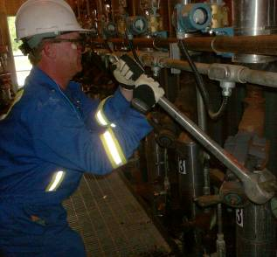
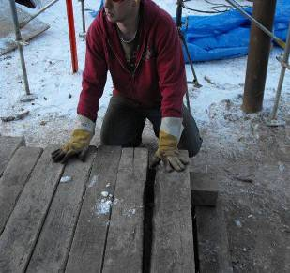
Familiarity with the Task (Complacency)
“He had done this task 500 times without hurting himself”
“We had stacked about 200 of them when ...”
Strategies for Reducing Tolerance
Situational Awareness – Treat every time like the first time .... ‘Stop and Think’
What could go wrong this time?
How would I teach a new person to do this?
Verbalize the steps of the task while doing it
How would I do this task with my/your child present
Notes:
The potential for work execution without having to refocus or refresh can create a blindness to the hazards and risks, thereby increasing risk tolerance due to familiarity.
Complacency is not laziness or lack of interest in job or not caring about results. Complacency occurs when the skill level is achieved where the task can be completed without the worker being fully focused on the task. The task can be completed based on habit and experience. (repetitive and completed correctly numerous times)
EXAMPLES:
The operator who runs 20 to 30 pigs a day. He opens and close similar valve assemblies in a shift. The opening and closing sequence is identical, no focus required due to repetitive process and no incidents have occurred.
The heavy equipment operator who climbs up and down his equipment several times a day. It’s the same task each time and is not the main part of the job (i.e. operating the equipment). Having never fallen off the ladder, he may get lulled into a sense of security where the three point contact on the ladder no longer seems to be important.

Slide 10
10 Factors That Influence Risk Tolerance
Overestimating Capability/Experience
Familiarity with the Task
Seriousness of Outcome
Voluntary Actions and Being in Control
Personal Experience with an Outcome
Cost of Non-Compliance
Confidence in the Equipment
Confidence in Protection and Rescue
Potential Profit & Gain from Actions
Role Models Accepting Risk
When we have had a personal experience in our past with a serious outcome, we will be less accepting of the risks associated with the activity.
Notes:
This factor is linked closely with risk tolerance factor #3 Seriousness of the Outcome. If in our past we have had a personal experience with a serious consequence of the activity, we will have lower acceptance or tolerance for risks associated with the activity. For example, if in our past we have lost a family member or a friend to a drunk driver, we are impacted by that and tend to have less tolerance for drinking and driving. And it is the same with work place activities.

Slide 11
Summary
2025 SAFETY EXCELLENCE AWARDS | BEST PRACTICES SEMINAR
Our owners truly understand that the MOST IMPORTANT ASSET they possess is the employees of Norrell and their families.
Norrell Construction’s Ownership, Leadership and Management have committed to continuing to train our employees in Risk Tolerance. This training is the baseplate for all other procedural training and sets the tone for our company.
Norrell’s leadership has committed to continue to grow this training so that future employees will have the same experience and will learn to value Risk Tolerance not only in the workplace but also in their daily lives.

Slide 12
Questions?
2025 SAFETY EXCELLENCE AWARDS | BEST PRACTICES SEMINAR

