Slide 1


Slide 2




2025 SAFETY EXCELLENCE AWARDS | BEST PRACTICES SEMINAR
TECHNICAL SUPPORT SMALL
BEST IN CLASS
GBR is a specialty roofing and safety solutions company focused on providing a safer alternative to traditional roof replacement by eliminating tear-off risks, heavy machinery, and fire hazards. Using Triton’s cold-applied Tritoflex Membrane System, we provide a stable, non-invasive process that minimizes disruptions, reduces exposure to hazardous materials, and ensures compliance with OSHA standards, making our entire project safer to workers and building occupants.

Slide 3


Slide 4
BEST PRACTICE
AGENDA / OUTLINE
Purpose
Execution & Implementation
Benefits & Results
Examples
Future Use & Applications
Summary & Wrap Up
Q&A

Slide 5

Purpose of Site App Pro
2025 SAFETY EXCELLENCE AWARDS | BEST PRACTICES SEMINAR
Site App Pro is a comprehensive digital solution designed to streamline health and safety compliance and site management for businesses across various industries, such as construction, manufacturing, logistics, and more. The app’s main purpose is to replace traditional paper-based processes with an intuitive, cloud-based platform that helps companies improve efficiency, reduce risk, and ensure regulatory compliance.
Centralize Health and Safety Processes
Improve Compliance and Safety
Enhance Site Visibility and Communication
Streamline Reporting and Auditing
Empower Field Teams

Slide 6
Execution & Implementation
2025 SAFETY EXCELLENCE AWARDS | BEST PRACTICES SEMINAR
Define Goals & Workflows
Get Buy-In
Set Up the App
Train Your Team
Pilot & Expand
Monitor & Improve

Slide 7
Benefits & Results
2025 SAFETY EXCELLENCE AWARDS | BEST PRACTICES SEMINAR
Improved Safety Compliance
Reduced Paperwork & Admin
Better Communication Across Teams
Greater Efficiency & Accountability
Professional Image & Client Confidence
Stronger Reporting & Insights

Slide 8
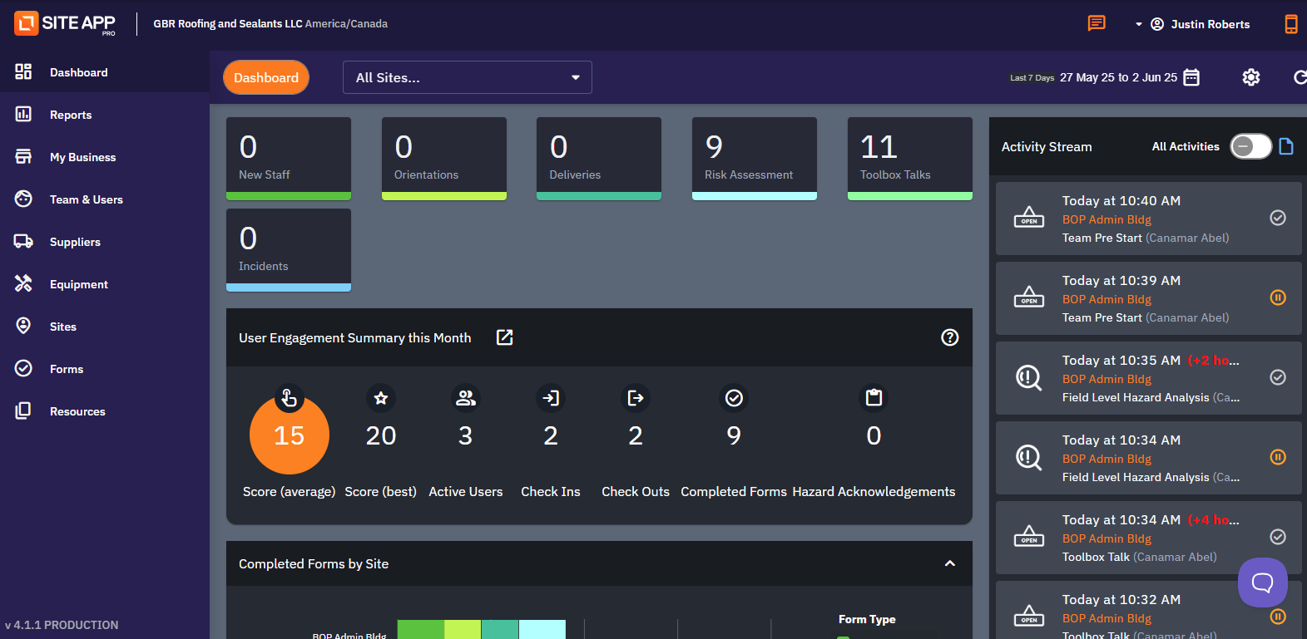
Examples
2025 SAFETY EXCELLENCE AWARDS | BEST PRACTICES SEMINAR

Slide 9
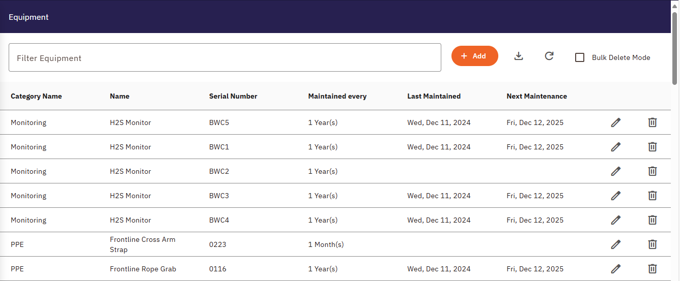
Examples Cont.
2025 SAFETY EXCELLENCE AWARDS | BEST PRACTICES SEMINAR

Slide 10
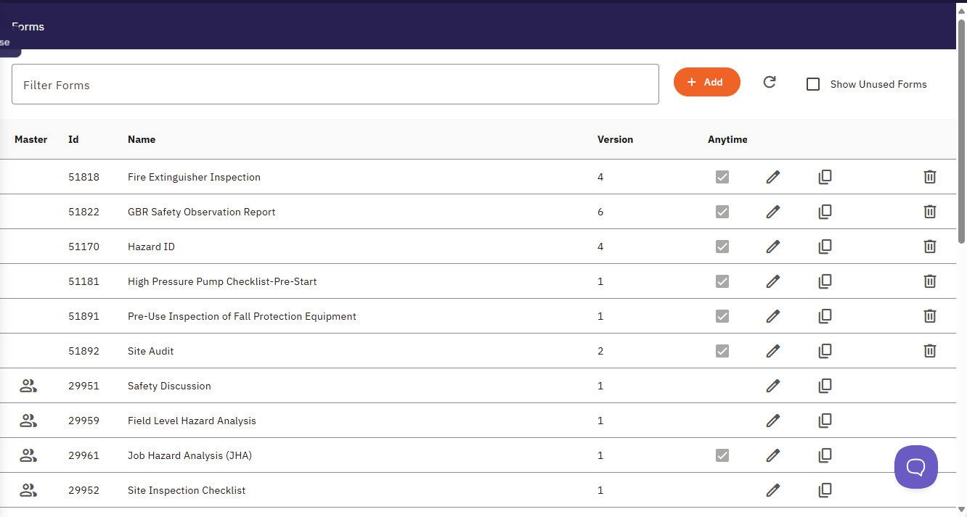
Examples Cont.
2025 SAFETY EXCELLENCE AWARDS | BEST PRACTICES SEMINAR

Slide 11
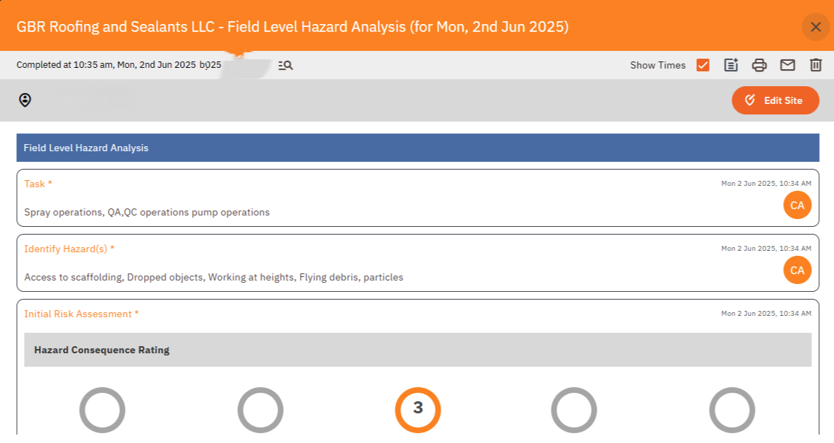
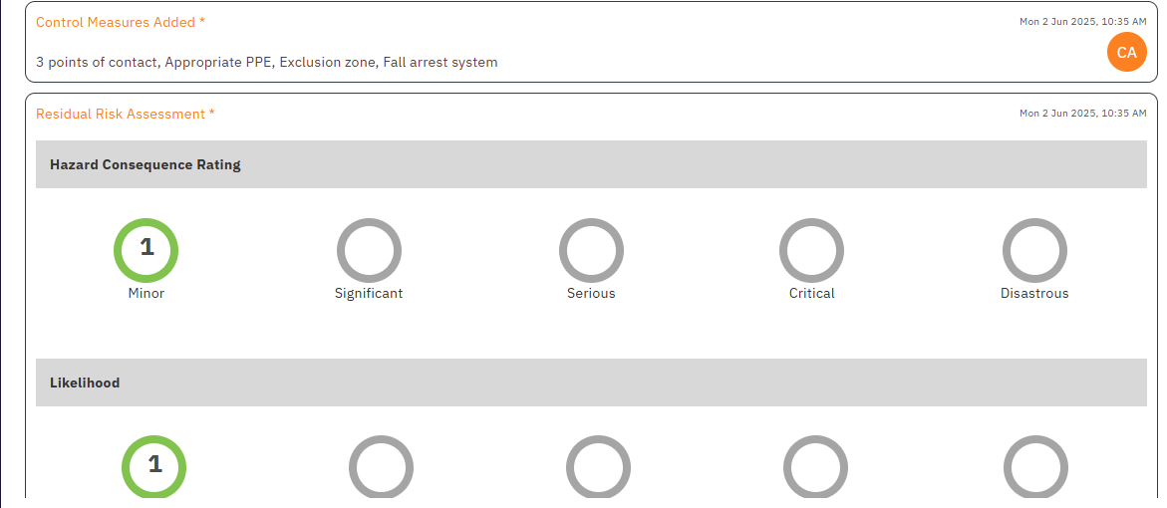
Examples Cont.
2025 SAFETY EXCELLENCE AWARDS | BEST PRACTICES SEMINAR

Slide 12
Future use & applications
2025 SAFETY EXCELLENCE AWARDS | BEST PRACTICES SEMINAR
Smarter Safety Management
Streamlined Site & Project Management
Equipment & Vehicle Oversight
Contractor & Subbie Management
Future Expansion & Compliance
Data-Driven Insights for Business Growth

Slide 13
Summary & Wrap up
2025 SAFETY EXCELLENCE AWARDS | BEST PRACTICES SEMINAR
Here at GBR Roofing and Sealants, we believe that Site App Pro isn’t just a tool, it’s a powerful asset that’s transforming how we work. By streamlining safety processes, enhancing communication, and giving us real-time insights, Site App Pro is helping us create safer, more efficient job sites every day.
This program is also incredibly user-friendly and can be operated seamlessly on tablets, phones, or computers, making it easy for our entire team to stay connected and compliant wherever they are.
As we look to the future, we see Site App Pro as a partner in our growth. Its flexibility and comprehensive features will support us as we take on bigger projects, expand our services, and continue to set the standard for quality and safety in the roofing and sealant industry.
We’re excited to keep leveraging this innovative platform to meet client needs, keep our people safe, and grow GBR Roofing and Sealants for years to come.
THANK YOU.

Slide 14

Questions?
2025 SAFETY EXCELLENCE AWARDS | BEST PRACTICES SEMINAR

